Slide 1

Decoding tumour phenotype by noninvasive imaging using a quantitative radiomics approach
Emre Beray Boztepe

Slide 2
Medical Imaging
The technique involves noninvasive assessment of human tissue characteristics for oncologic diagnosis and treatment guidance.
Goal: Personalized Medicine - Tailoring treatment based on patient and disease characteristics using molecular characterization.

Slide 3
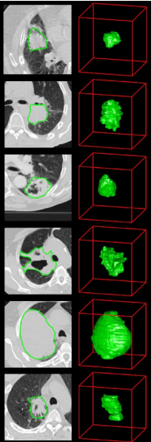
X-ray Computed Tomography (CT)
The most widely used imaging modality in oncology which assesses tissue density.
Phenotypic differences can be captured with routine CT imaging. (intratumour heterogeneity, tumour shape)

Slide 4
Radiomics
Emerging field that converts imaging data into a high dimensional mineable feature space using many automatically extracted data-characterization algorithms.
These imaging features capture distinct phenotypic differences of tumours and may have prognostic power

Slide 5
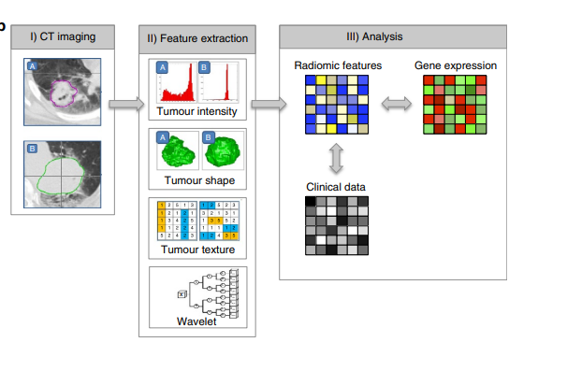
Association of radiomic data with clinical data
RIDER – Stability Rank Features
Multiple Delineation – Stability Rank Features
Lung1 – Training
Lung2 - Validation
H&N1 - Validation
H&N2 - Validation
Lung3 – Gene-Expression
Image features describing tumour phenotype characteristics by:
Tumour image intensity
Shape
Texture
Multiscale wavelet

Slide 6
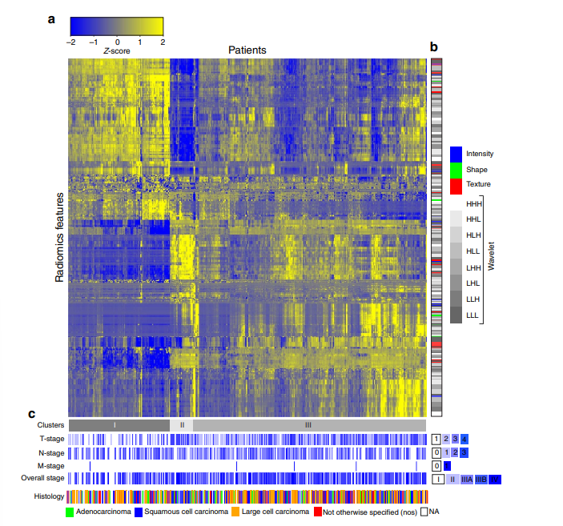
T-stage -> P<1x10⁻²⁰ (x² test),
significant association with primary tumour stage (Cluster I)
Overall stage -> P = 3.4x10⁻³ (x² test),
significant association with primary tumour stage (Cluster I)
N-stage (lymph node) -> P = 0.46 (x² test),
no correspondence with the radiomic expression patterns
M-stage (metastasis) -> P = 0.73 (x² test),
no correspondence with the radiomic expression patterns
Histology -> P = 0.019 (x² test),
significant association with histology wherein squamous cell carcinoma showed a higher presence (Cluster II)
FDR - the expected proportion of false discoveries amongst the rejected hypotheses

Slide 7
Prognostic value of radiomic data
Radiomic features were not normalized, raw values computed from DICOM images.
Median values from Lung1 were used as thresholds in validation datasets.
Survival differences for numerous features (median threshold from Lung1 ):
Lung2 (238/440 almost %54)
H&N1 (135/440, %31)
H&N2 (186/440, %42)

Slide 8
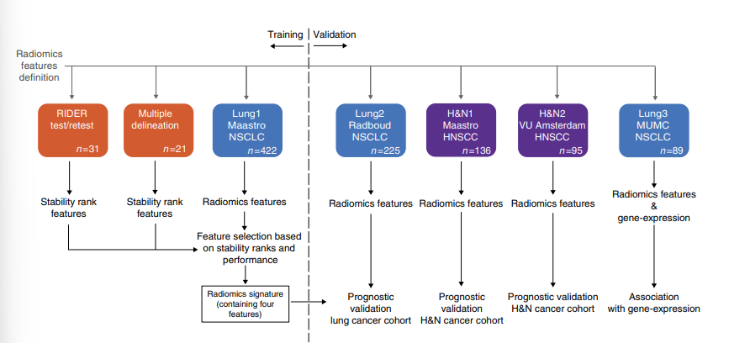
Building prognostic radiomic signature
Stability rank features:
RIDER - was used to assess the consistency of radiomic features between the two scans.
Multiple Delineation - was used to test the stability of the radiomic features
The resulting radiomic signature consisted of:
Statistics Energy – describing the overall density of the tumour volume.
Shape Compactness (Feature 16) - quantifying how compact the tumour shape is.
Grey Level Nonuniformity (Feature 48) - a measure for intratumour heterogeneity.
wavelet ‘Grey Level Nonuniformity HLH’ (Feature Group 4) - also describing intratumour heterogeneity after decomposing the image in mid-frequencies.
Friedman Test: A nonparametric repeated measurement test for a non-Gaussian population.

Slide 9
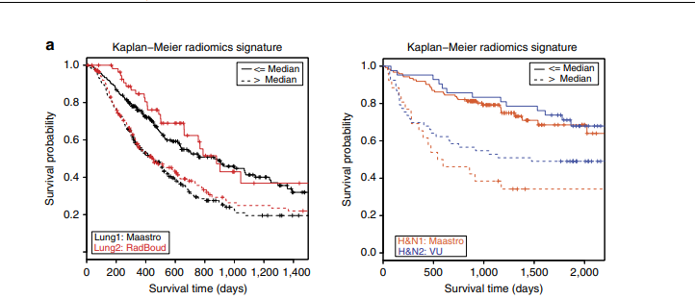
Prognostic validation of radiomic signature
Concordance Index (CI): A generalization of the area under the ROC curve.
Evaluation of the performances:
Good performance on Lung2 data (CI = 0.65, P = 2.91 x 10⁻⁰⁹, Wilcoxon test)
High performance on H&N1 (CI = 0.69, P = 7.99 x 10⁻⁰⁷, Wilcoxon test)
High performance on H&N2 (CI = 0.69, P = 3.53 x 10⁻⁰⁶, Wilcoxon test)

Slide 10
Radiomic Signature vs. the TNM staging (providing a standardized way to describe the extent of cancer in a patient's body):
Signature performance was better in both Lung2 and H&N2 and comparable in H&N1.
Combining the radiomic signature with TNM staging showed a significant improvement in all data sets.

Slide 11
Human papillomavirus (HPV): An important determinant in head-and-neck cancer patients.
No significant association between radiomic signature prediction and HPV status in a combined analysis in the H&N1 and H&N2 data set (P = 0.17, Wilcoxon test).
Signature preserved its prognostic performance in the HPV-negative group (CI = 0.66), consisting of most patients (76%, n = 130)

Slide 12
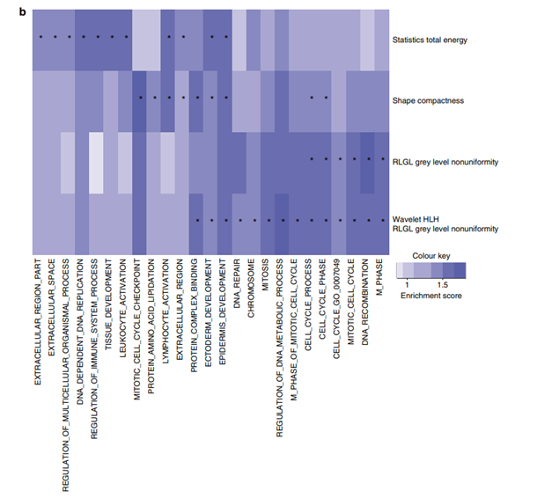
Comparation of the radiomic signature with gene-expression profiles (Lung3 data set) using gene-set enrichment analysis (GSEA) significant associations between the signature features and gene-expression patterns has found.
The corresponding normalized enrichment scores (NES) - GSEA’s primary statistic

Slide 13
Discussions
The study demonstrates the strong prognostic value of a radiomic signature in these cancers.
The radiomic signature outperformed TNM staging in predicting outcomes.
Overall, the lung-derived radiomic signature had better performance in head and neck compared with lung cancer

Slide 14
Thank You

